Slide 1
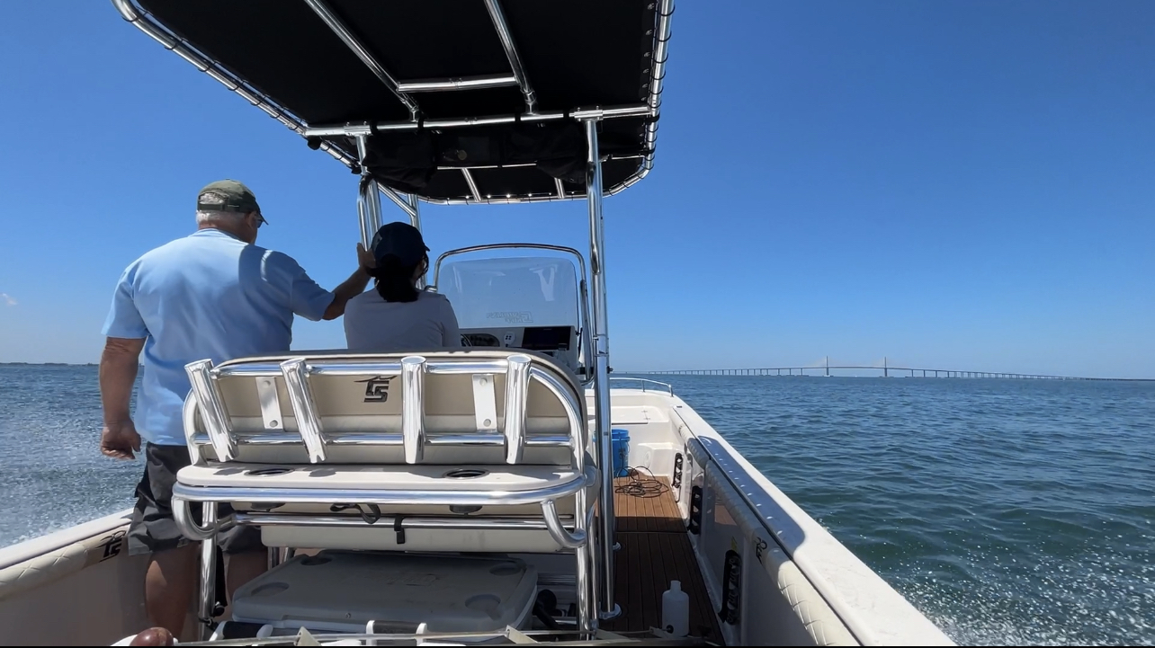
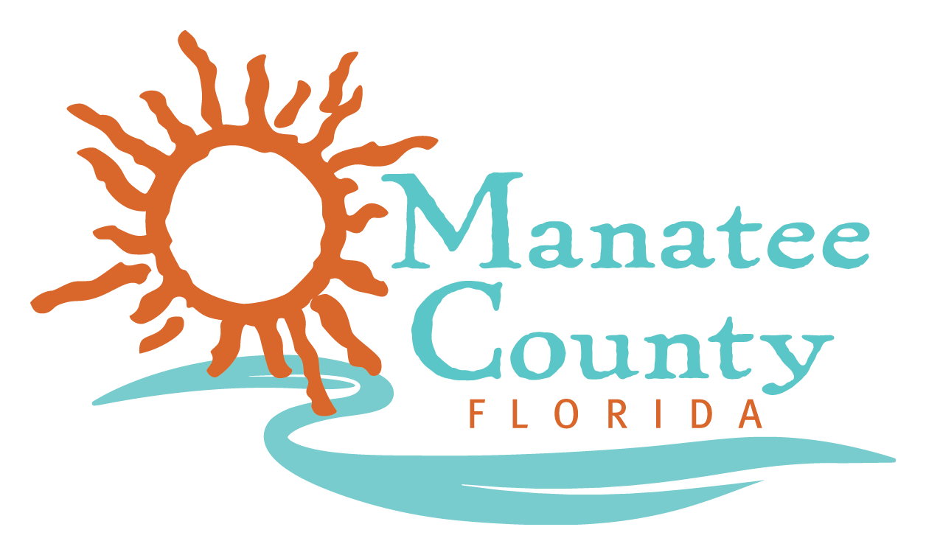
EPD Internship Project: Developing an Efficient Method of Investigating Algal Blooms
Intern: Brendan McKnight, Mentor: Greg Blanchard

Slide 2
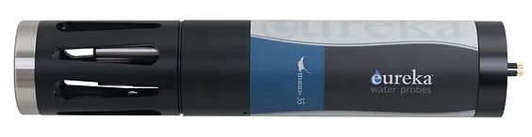
Purpose
Efficient algae level monitoring method needed for control, prevention, and event response to algae blooms
Manatee County would benefit from more efficient method of monitoring
By correcting field measurement equipment procedures, I was able to develop a method of efficiently monitoring algae levels
Notes:
Federal programs aimed at managing algae levels emphasize the importance of access to efficient monitoring procedures. This is necessary to be able to respond quickly and investigate how we can mitigate algae levels. Current monitoring procedures used by Manatee County are too inefficient to manage algae levels properly in our waterways. By correcting field measurement equipment procedures, I was able to develop a method of efficiently monitoring algae levels that gives Manatee County opportunities to further the battle to protect our waterways.

Slide 3
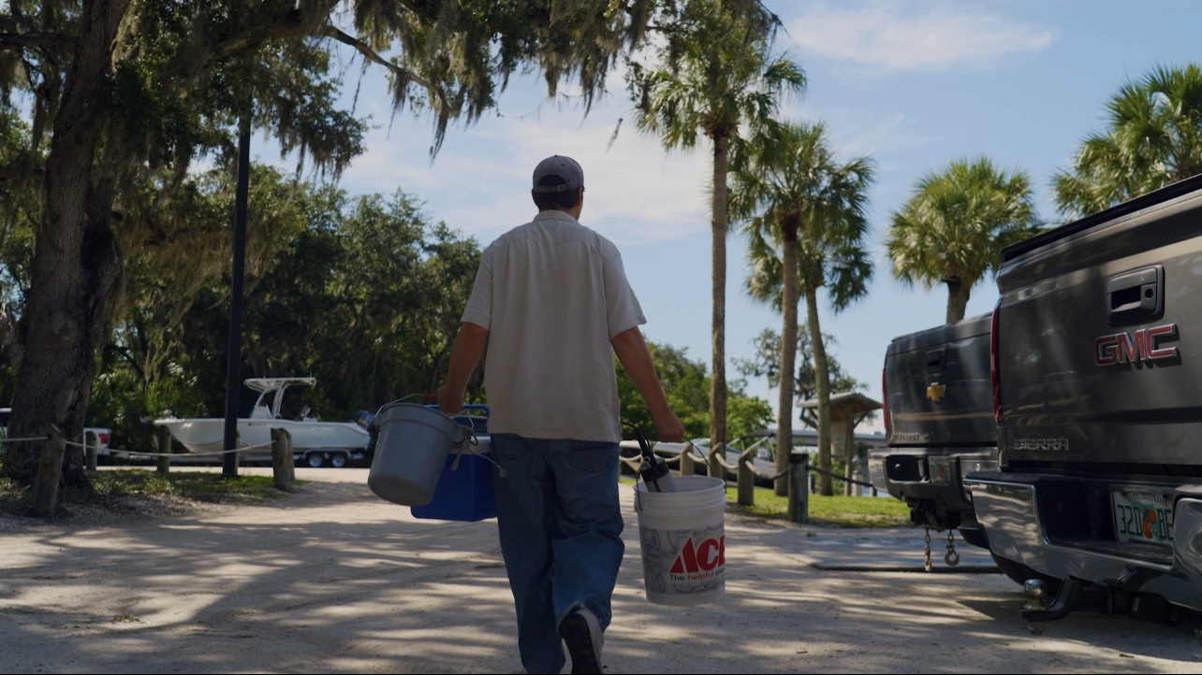
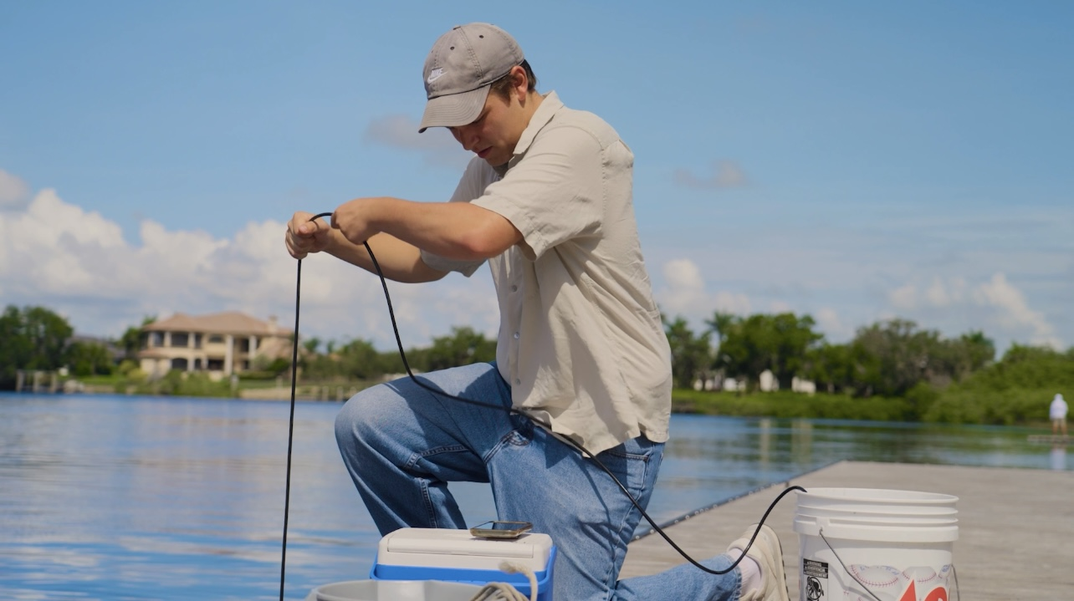
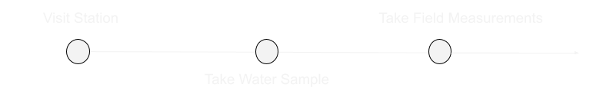
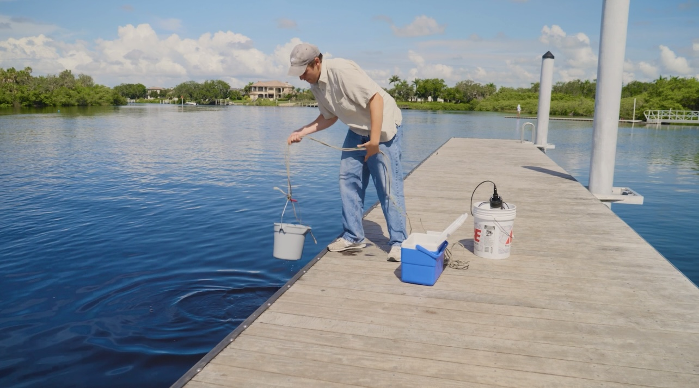
Methods

Slide 4
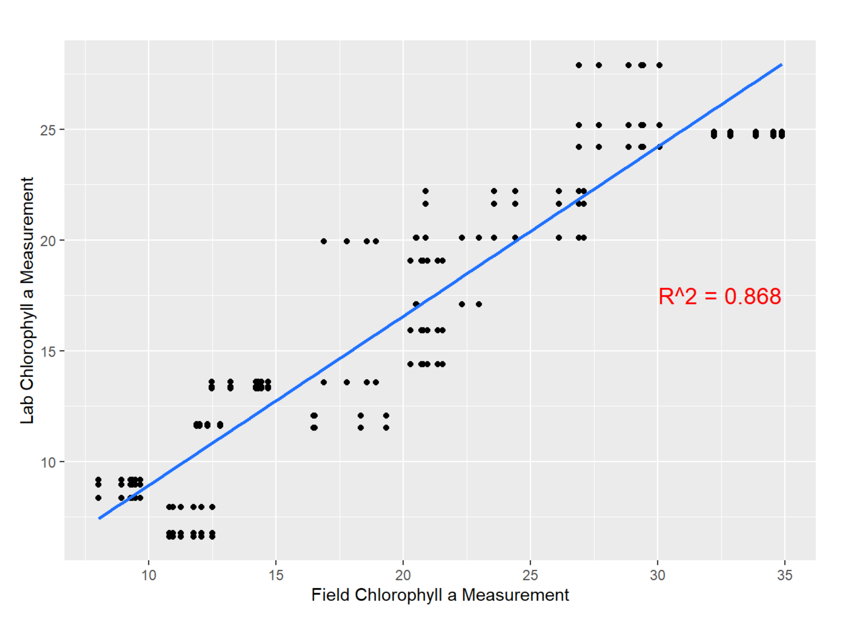
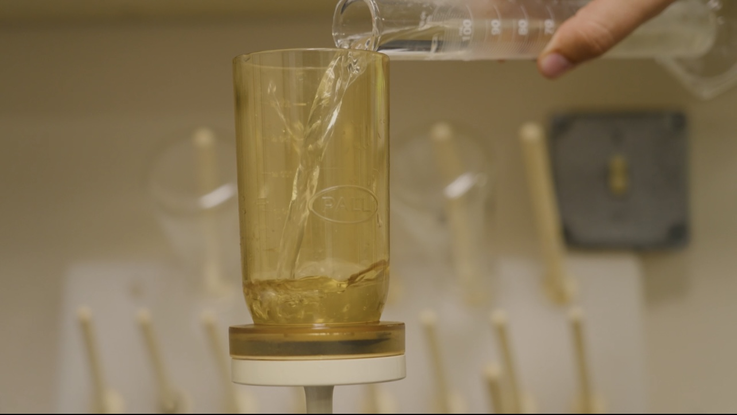
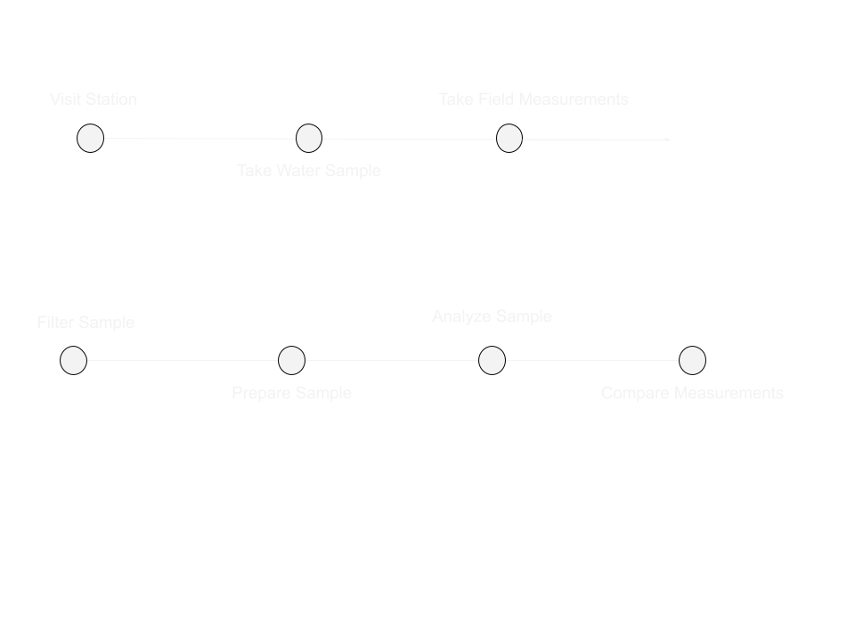
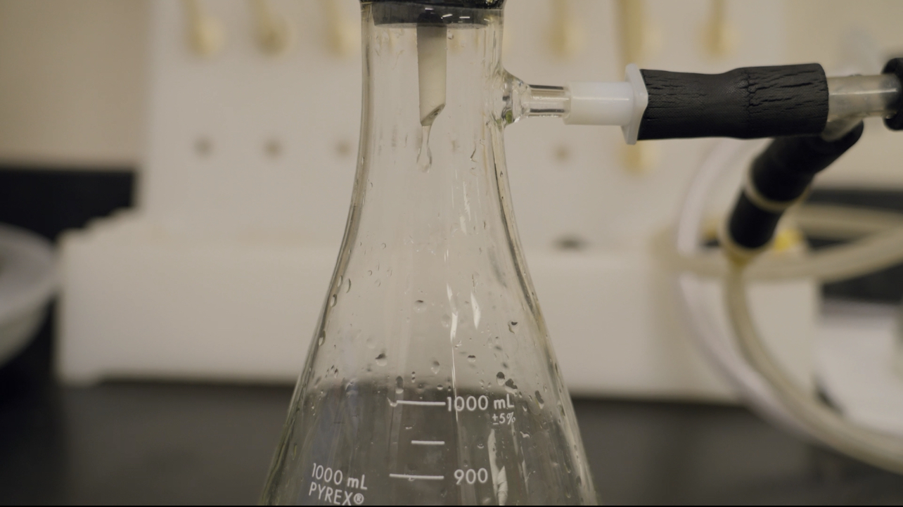
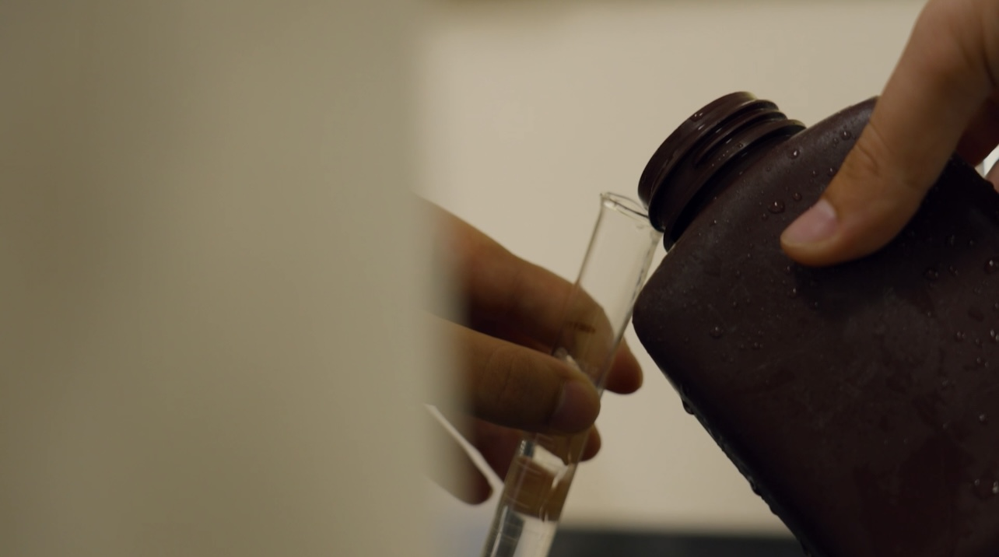
Methods
Notes:
Visited water quality stations across the county
Collected water samples and recorded measurements taken from water quality equipment
Analyzed water samples and compared values to expected values from water quality equipment
Ran statistical tests on data to determine correction formula, proper depth and measurement techniques

Slide 5
Results
Developed methodology for efficient algal level monitoring
Set of best measurement procedures identified
Correction formula determined
Published website to share results and directions for correcting accuracy
Method will be employed for water quality protection efforts and stormwater management

Slide 6
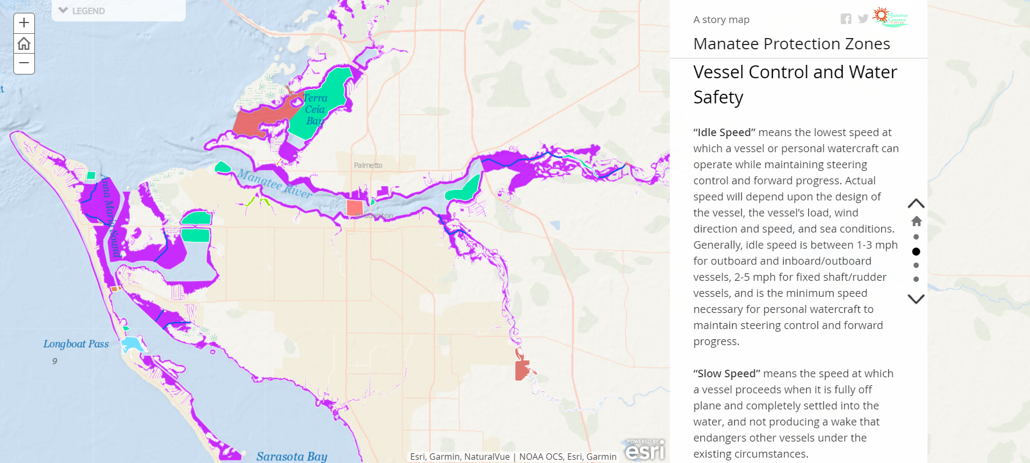
Future Implications
Possible algae monitoring uses
System for predicting blooms
Up to date map of algae levels and algal blooms available for citizens
Investigate efforts to reduce nutrient availability in waterways

Slide 7
Questions

